Slide 1

Hotel Cancellation Project
Suna Buse Agkoc

Slide 2

Agenda
Problem Statement and Project Goals 3
Introduction to Dataset 4
Data Preparation 5-6
Exploratory Data Analysis 7-11
Model Building 12
Model Comparison 13-15
Business Recommendations 16
Limitations 17

Slide 3

Problem Statement and Project Goals
In the hospitality industry, the uncertainty of hotel bookings, driven by cancellations and no-shows, creates notable logistical and financial complications.
Effective prediction and management of cancellations are key for optimized resource allocation, revenue management, and customer satisfaction.
The goal: to address the uncertainty of hotel bookings by creating a model that can predict possible booking cancellations. This information will help us plan our resources better and guide us in creating targeted marketing strategies and improving our services to meet our customers' needs.
Target Audience:
Hotel Owners
Hotel Customers
Travel Agencies

Slide 4
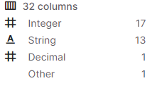
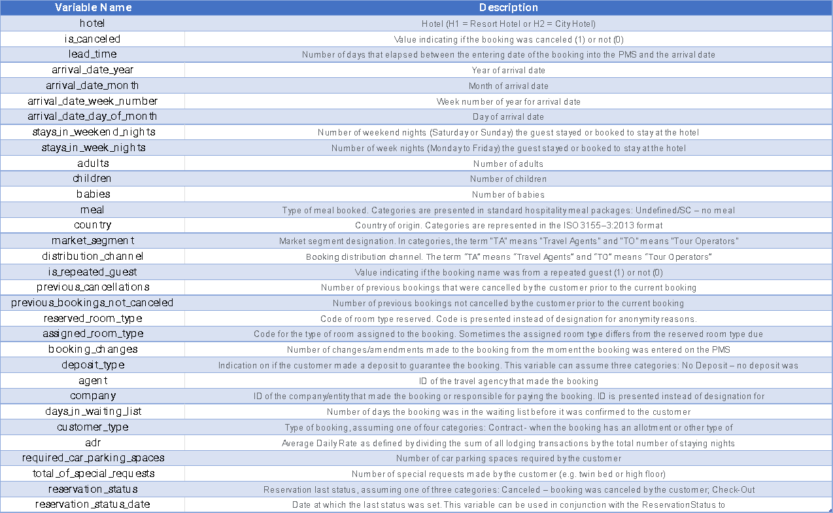
Introduction of Dataset

Slide 5
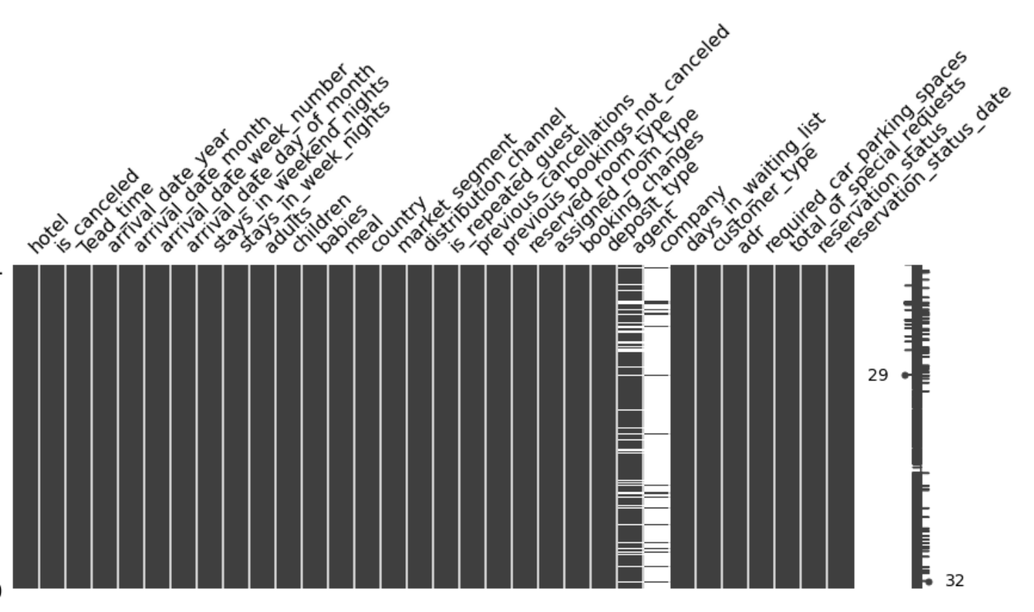
Data Preparation
Missing values:
Dropped columns with high missing values (i.e., agent, company)
Replaced missing values in the “children” column with zeros.
Replaced “Undefined" with "SC" in the "meal" column.

Slide 6
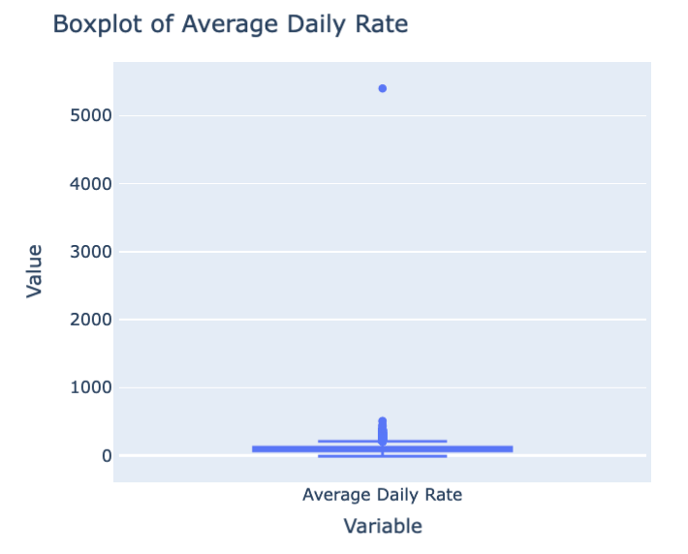
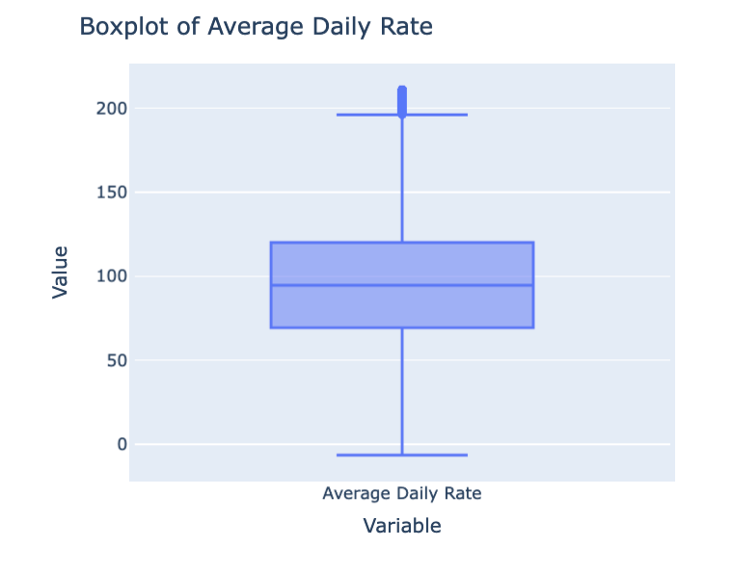
Data Preparation
Outliers:
Created an interactive tool for generating boxplots for all numerical variables to visually identify and handle potential outliers.
Used the Interquartile Range (IQR) method to identify and remove outliers in the Average Daily Rate (‘adr’) variable.
Created two new features, 'Stay_Nights_Total' and 'Stay_Cost_Total', derived from existing columns, enhancing the exploratory data analysis.

Slide 7
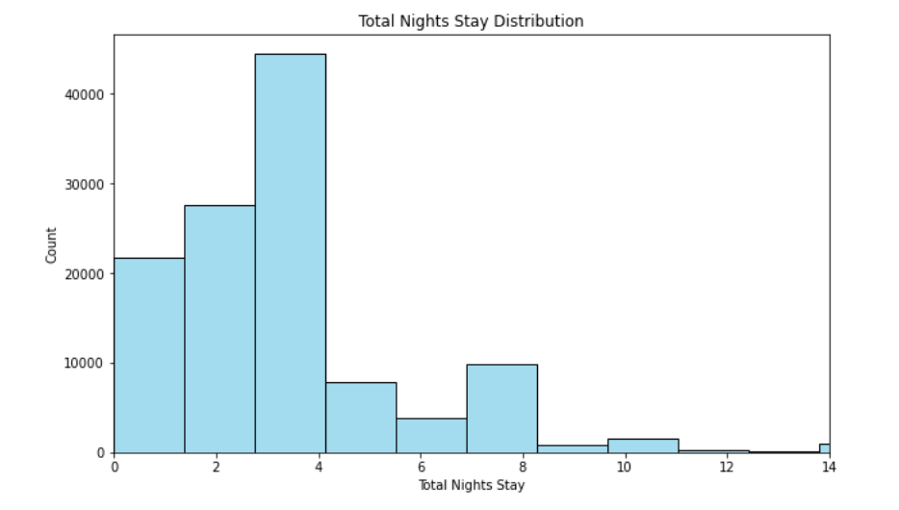
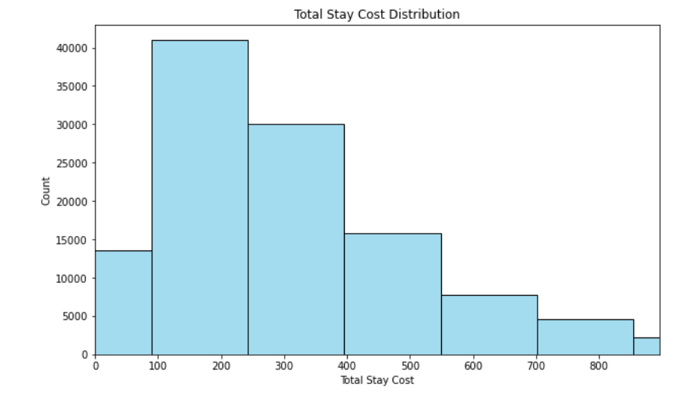
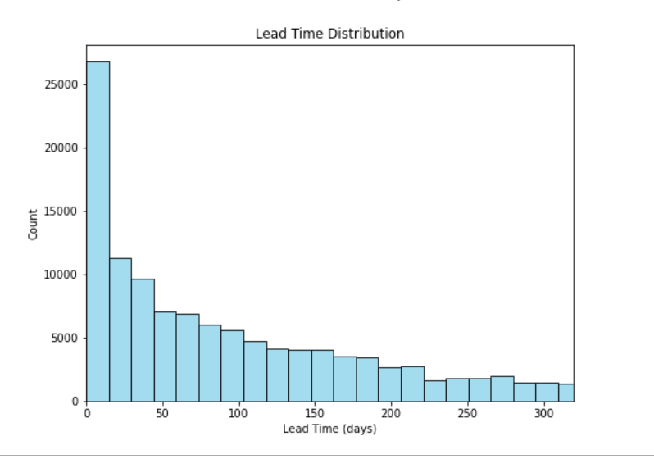
Exploratory Data Analysis- Univariate

Slide 8
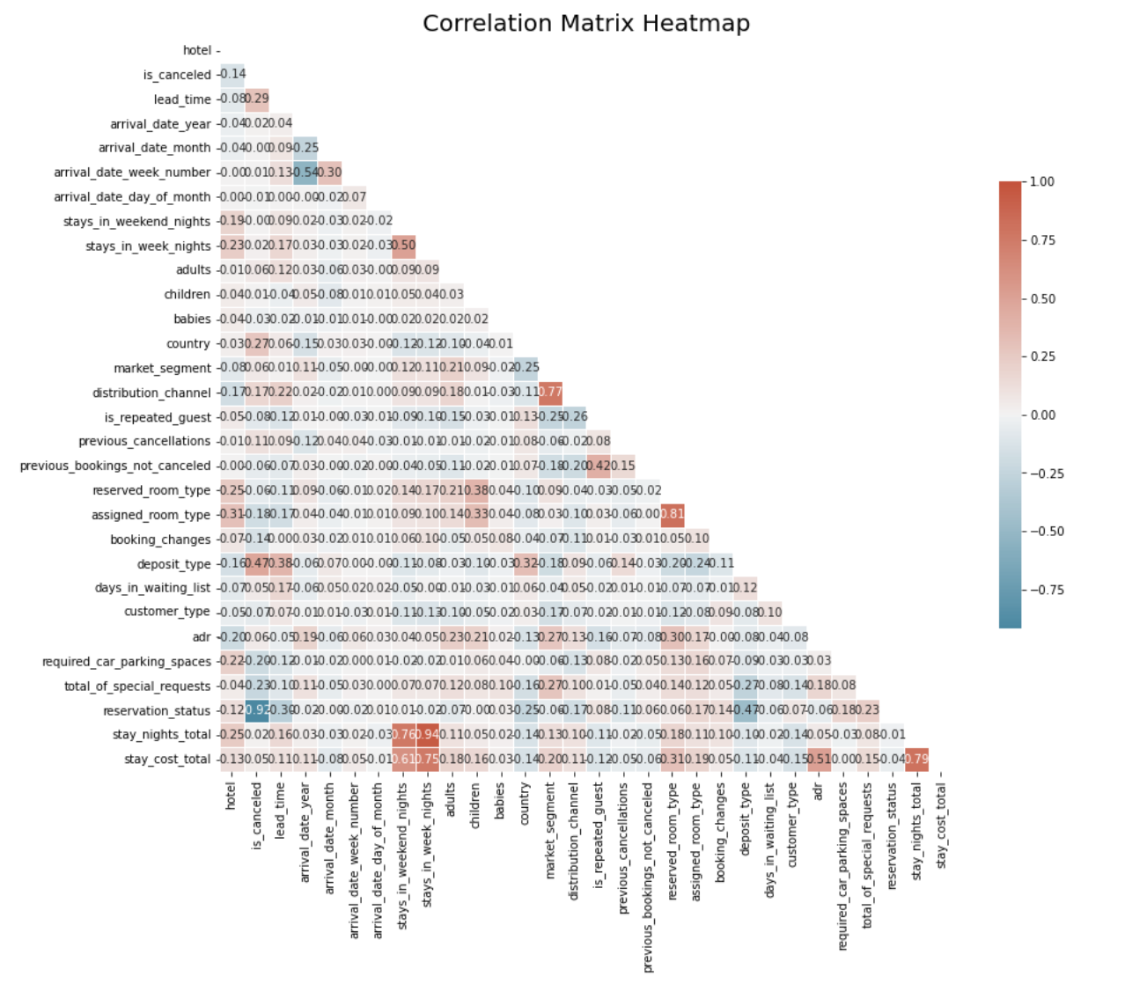
Exploratory Data Analysis-Multivariate
Correlational Matrix:
Distribution Channel and Market Segment
Assigned Room Type and Reserved Room Type
Reservation Status and Is Cancelled
Stay Nights Total and Stays in Weekend Nights & Stays in Weeknights
Stay Cost Total and Stays in Weekend Nights, Stays in Weeknights & Stay Nights Total

Slide 9
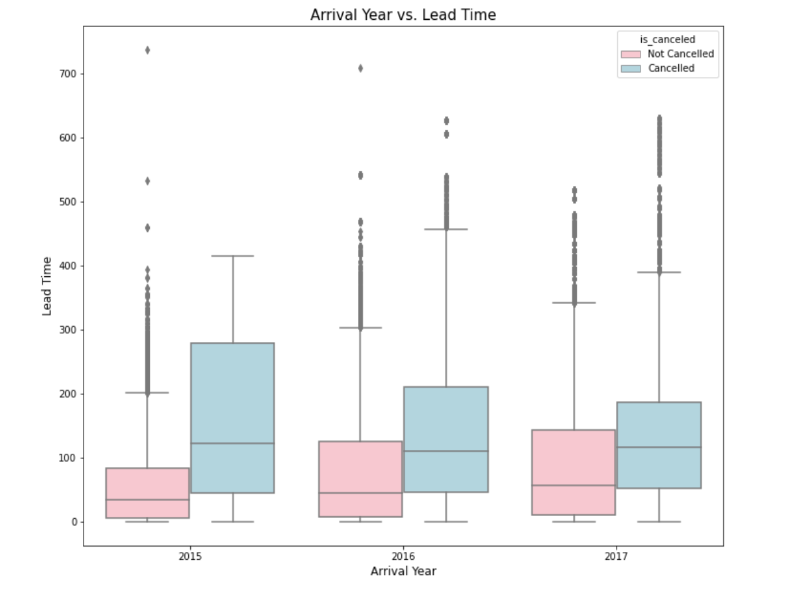
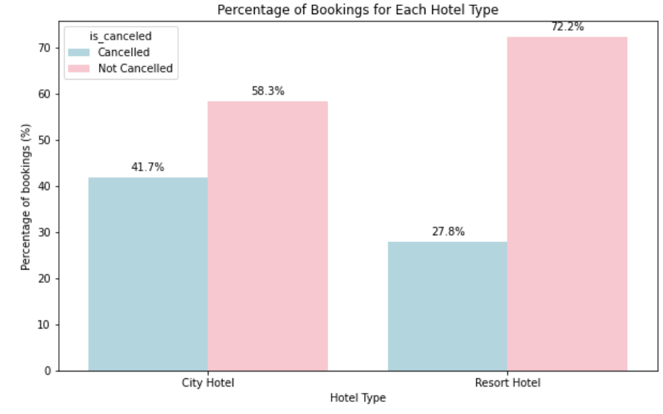
Exploratory Data Analysis

Slide 10
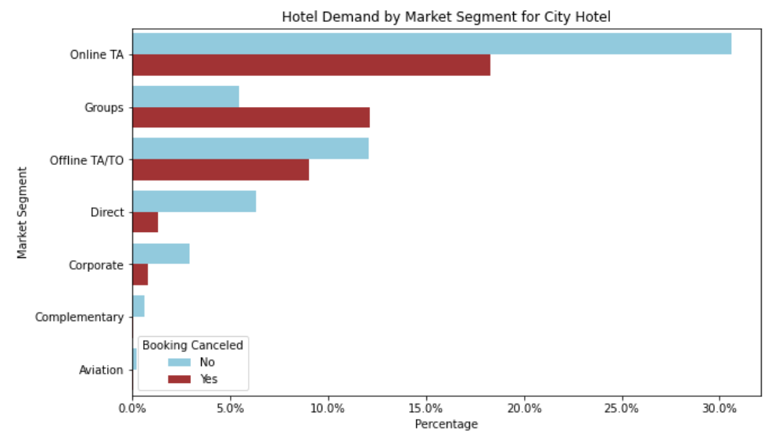
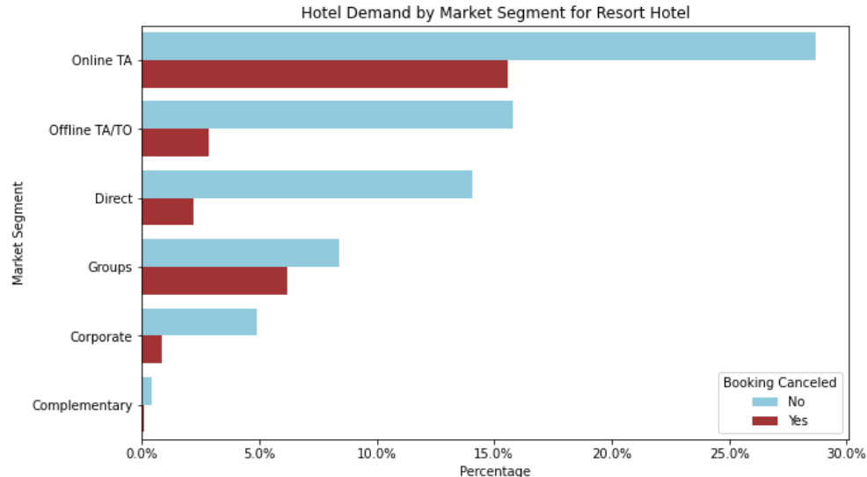
Exploratory Data Analysis

Slide 11
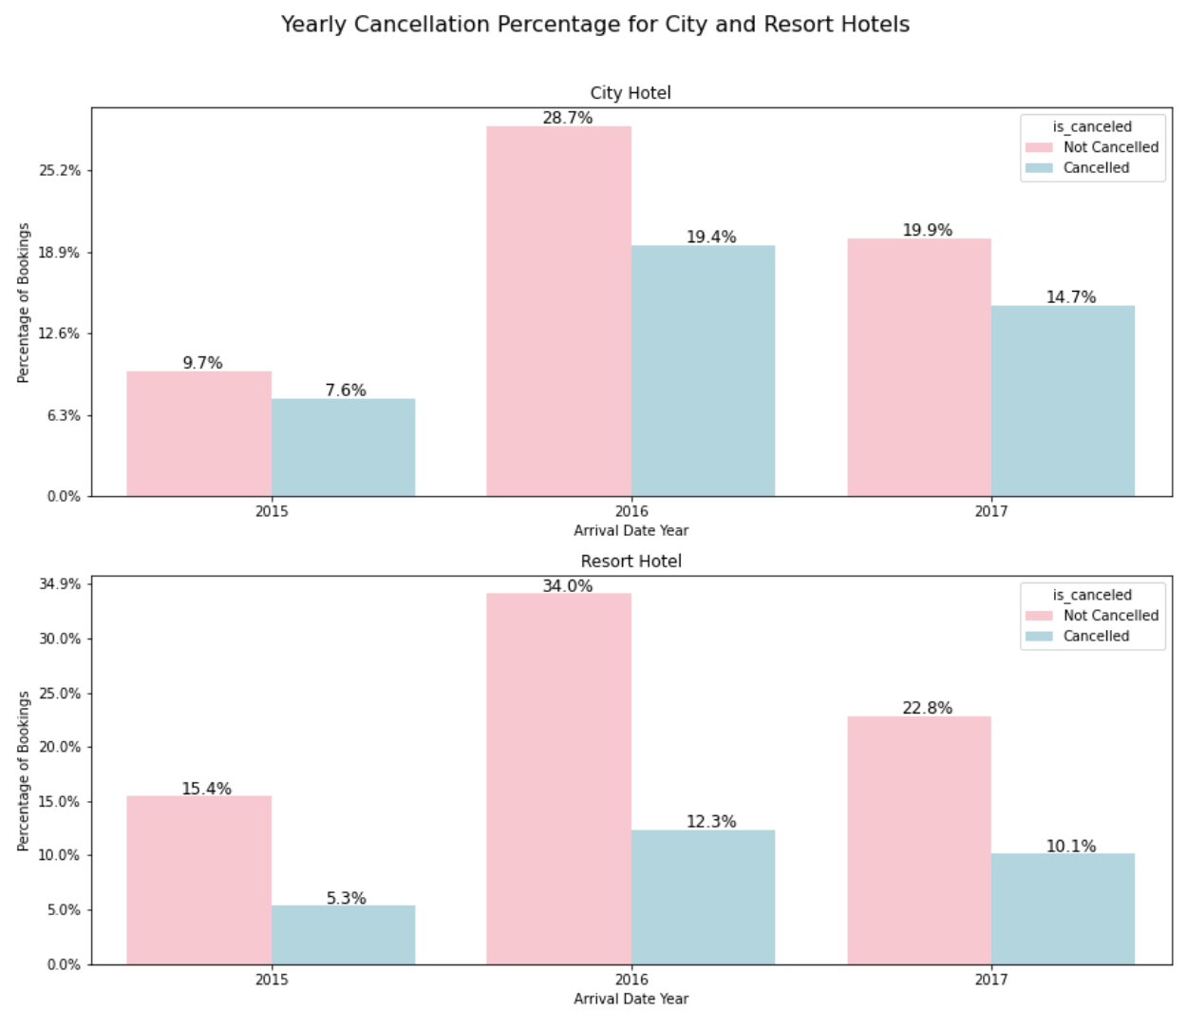
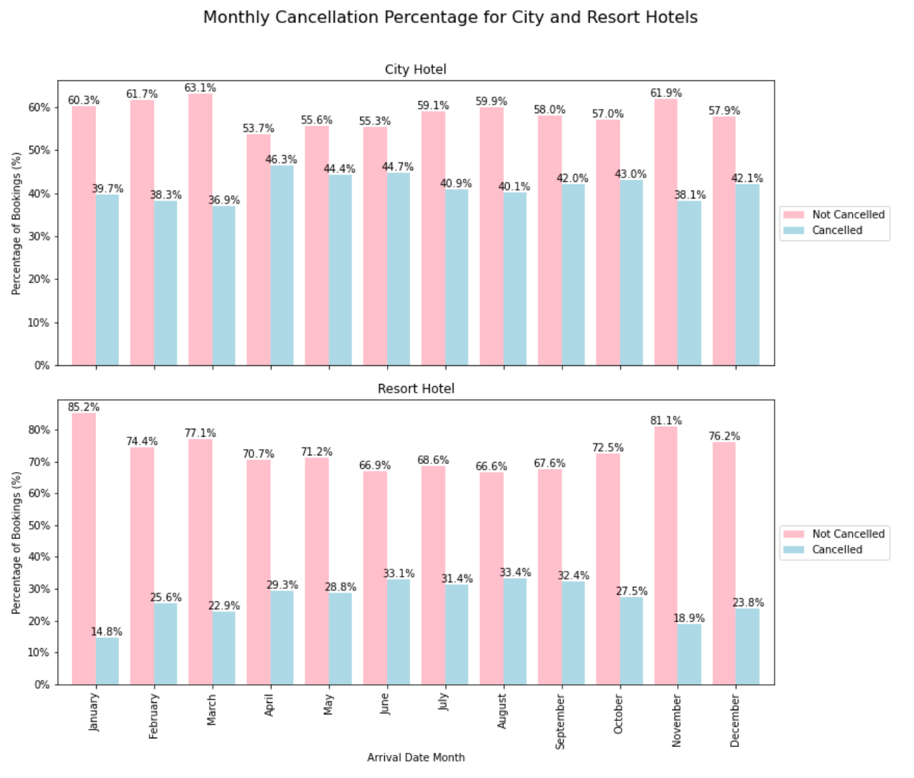
Exploratory Data Analysis

Slide 12

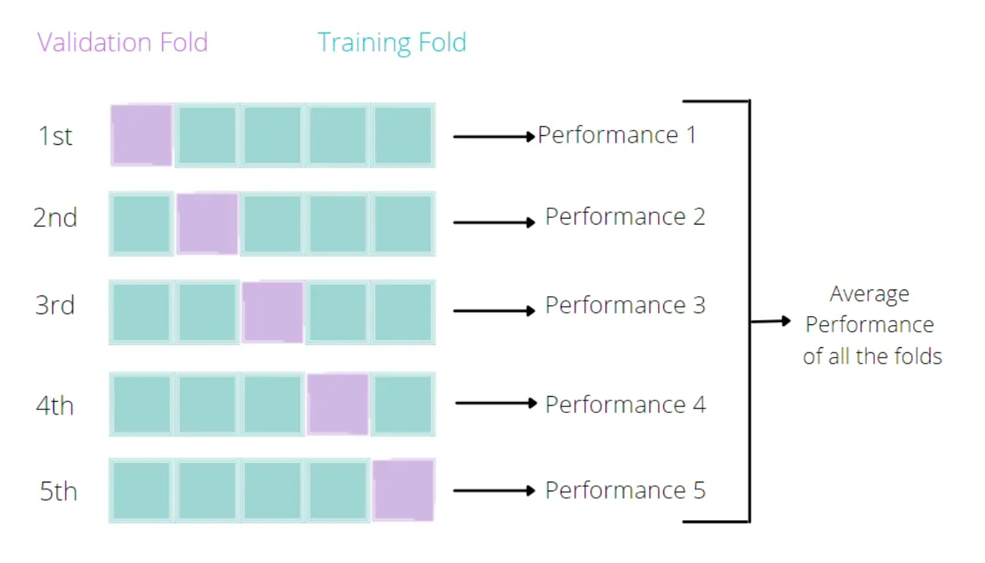
Model Building
Classification Models:
Logistic Regression
Decision Tree
Random Forest
Key Points:
Split the Train/Test data by 80:20 ratio
Shuffle the dataset
Randomization
Cross Validation (10th Fold)
Hyperparameter Tuning

Slide 13
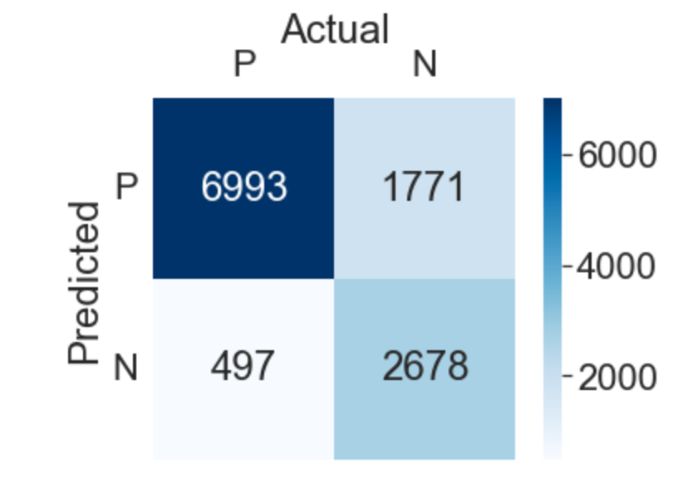
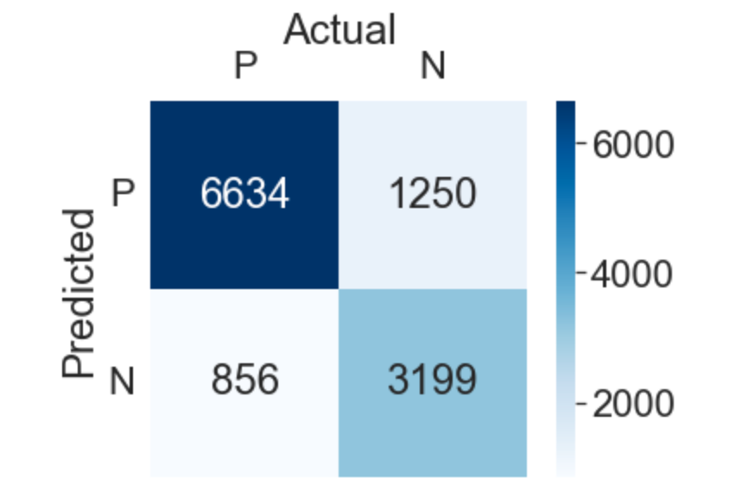
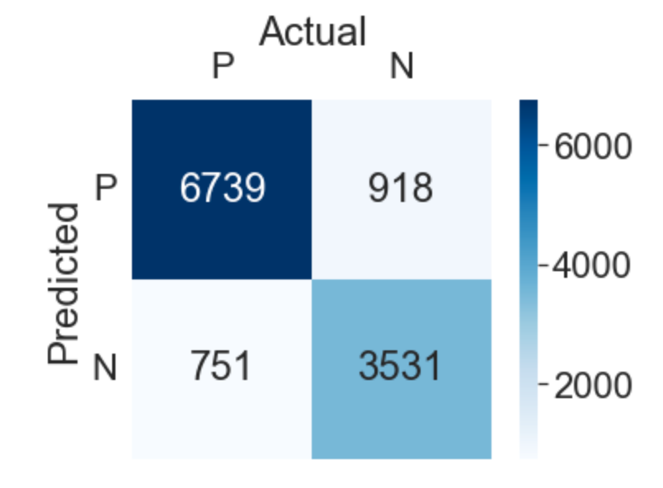
Model Comparison
Logistic Regression
Decision Tree
Random Forest
Accuracy : 0.81
Precision : 0.80
Recall : 0.93
F1 : 0.86
Accuracy : 0.82
Precision : 0.84
Recall : 0.89
F1 : 0.86
Accuracy : 0.86
Precision : 0.88
Recall : 0.89
F1 : 0.88

Slide 14
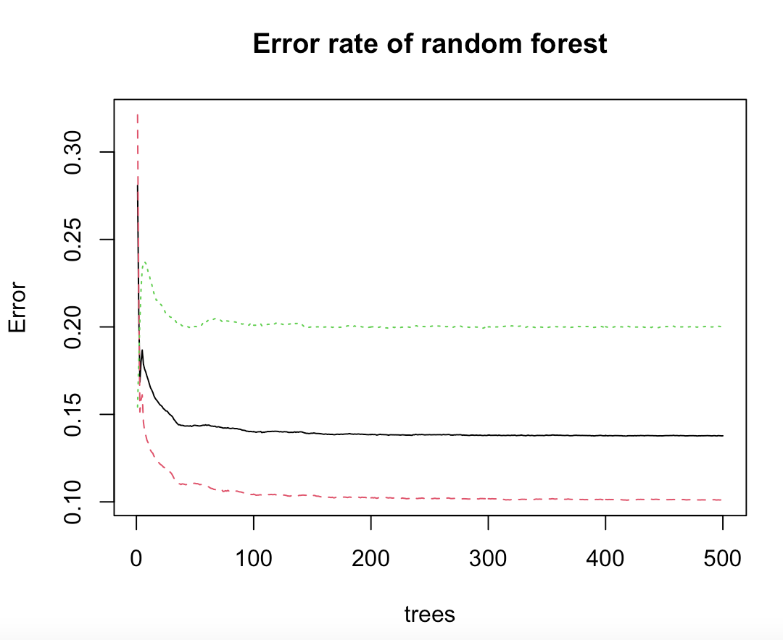
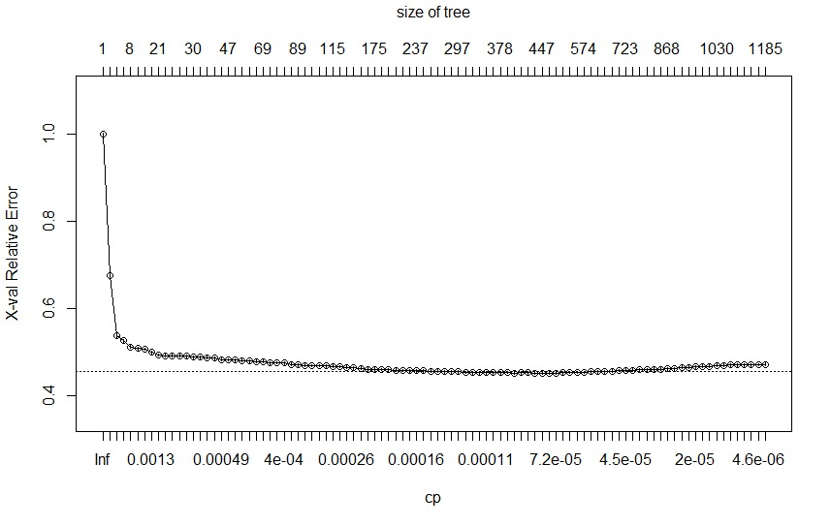
Error Term and Tuning
Decision Tree X-val Relative Error

Slide 15
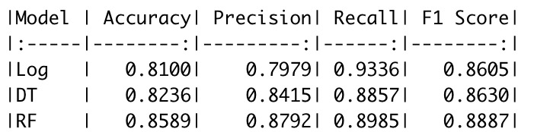
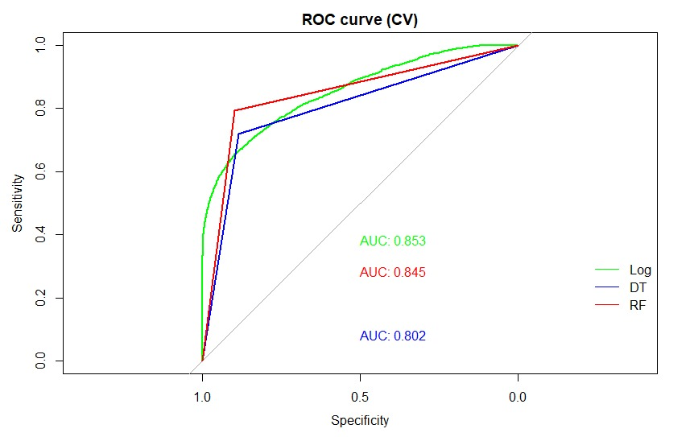
Tuning and ROC
Hyperparameters:
Maxdepth: Depth the tree will grow to, the deeper, the more complex, but less training errors.
Cutoff: Threshold to define a probability of a positive event
Mtry: Number of variables or features to randomly sample for each split
Sampsize: How many units to sample from each class

Slide 16
Business Recommendations
Seasonal Marketing Strategy: Cancellations show a seasonal pattern, peaking in the summer months. Consider tailoring marketing efforts to fill these vacancies, such as promotional deals during these high cancellation months.
Targeting Specific Countries: Certain countries have notably higher booking rates. Design marketing strategies targeted at these regions to further boost bookings and revenue.
Customer Segmentation: Certain customer segments (e.g., customers from particular countries, booking through specific channels) show different cancellation patterns. Marketing efforts can be tailored for these segments to reduce cancellation rates.
Price Adjustments: The model found a relationship between ADR and cancellation likelihood. Explore price adjustments during peak seasons to discourage cancellations.
Differentiating Between Hotel Types: The cancellation patterns between City Hotels and Resort Hotels are notably different. Thus, consider developing separate strategies for each hotel type.
Dynamic Pricing : A dynamic pricing strategy could be explored where prices are adjusted in real-time based on occupancy rates and cancellation predictions to maximize revenue.

Slide 17
Limitations
Real-Time Data: The current model is built on historical data and may not fully capture real-time booking dynamics. Extracting real-time data using AWS or other cloud technologies could significantly improve the predictive power and practicality of the model.
External Factors: The model doesn't account for external factors such as economic conditions, weather, or special events that could impact booking and cancellation patterns. Incorporating these data could improve the model.
Feature Engineering: Although new features were created for exploratory analysis, they were not included in the model due to multicollinearity. Future models could benefit from additional feature engineering and selection strategies.
Machine Learning Model: The predictive model performed well, but there's still room for improvement. More advanced machine learning techniques or deep learning could be used to further boost performance.
Bias towards Frequent Bookers: The model may be biased towards guests who book more often as they are more represented in the data. Future iterations of the model could address this potential bias.
Integration with Existing Systems: The integration of the model with the hotel's existing booking systems could be challenging and needs to be explored further.

Slide 18

References
Hotel booking demand datasets - ScienceDirect
Hotel booking demand | Kaggle

Slide 19
Thank You

